Slide 1
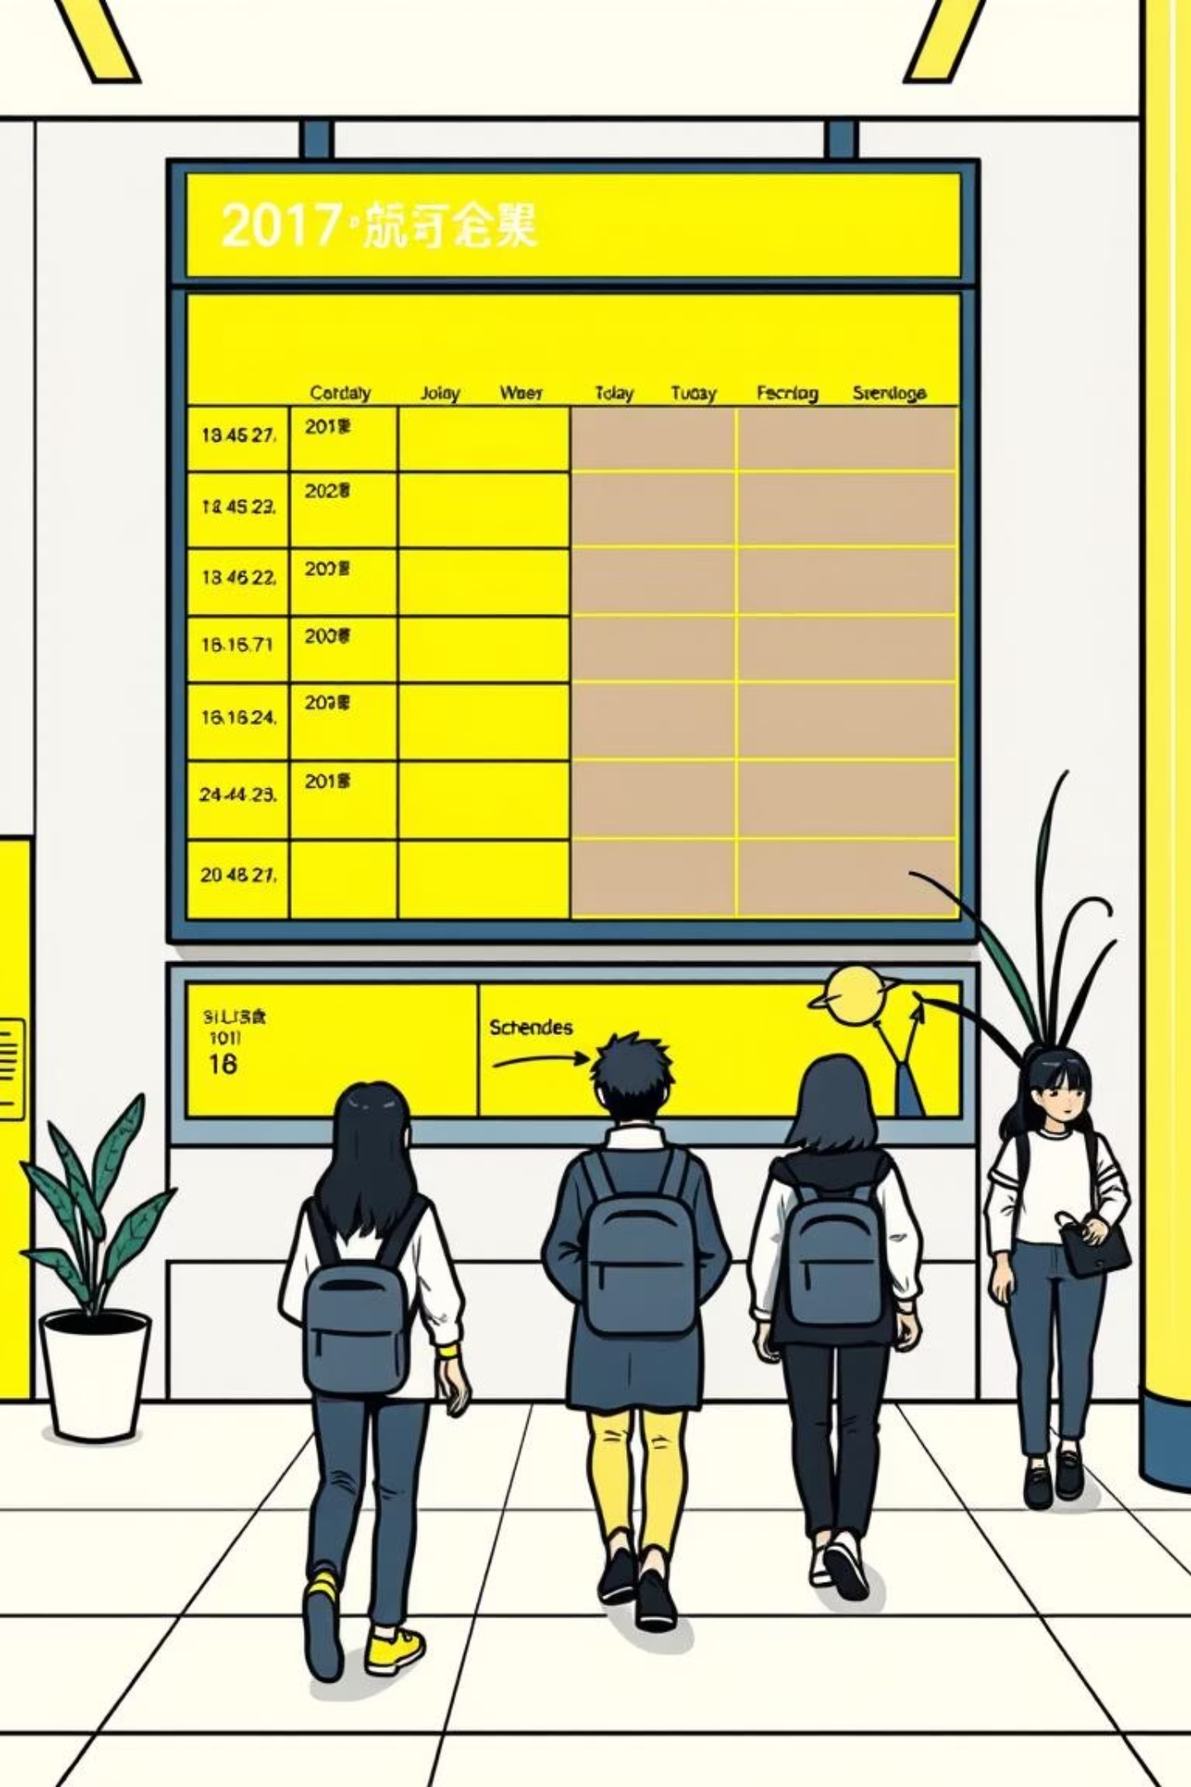
AI-Powered Timetable Scheduling
Genetic Algorithms & CSP Heuristics

Slide 2

The Problem: Complexity of Timetable Creation
Scheduling requires balancing hundreds of constraints: instructor availability, room capacity, student course preferences, facility requirements, and time conflicts. Manual methods are error-prone and time-consuming, often requiring weeks of painstaking adjustments.
Hundreds of Variables
Hard Constraints
Classes, instructors, rooms, time slots
No instructor double-booking
Soft Constraints
Minimize gaps between classes

Slide 3

Traditional Approaches & Their Limitations
Manual Scheduling
Rule-Based Systems
Labor-intensive and error-prone
Rigid, inflexible rules
Cannot adapt to changing requirements
Weeks of back-and-forth adjustments
Often produce suboptimal solutions
Inconsistent quality across terms
Expensive to maintain and update
Limited scalability for growth

Slide 4



Introducing AI: A Smarter Way to Schedule
Artificial intelligence automates complex constraint optimization, finding near-optimal solutions in minutes. AI learns from patterns, adapts to new requirements, and continuously improves scheduling quality while reducing manual workload significantly.
Traditional
Manual effort, weeks
AI-Powered
Automated, minutes

Slide 5
Genetic Algorithms: Evolution in Scheduling
Genetic algorithms mimic natural evolution: creating initial schedule populations, evaluating fitness based on constraint satisfaction, and evolving superior solutions through selection and crossover. This approach explores vast solution spaces efficiently, discovering creative scheduling arrangements humans might miss.
Initialize Population
Generate random candidate schedules
Evaluate Fitness
Score each schedule against constraints
Selection & Reproduction
Best schedules breed next generation
Mutation & Crossover
Introduce variations to explore new solutions
Convergence
Evolve toward optimal schedule

Slide 6

Constraint Satisfaction Problems (CSPs) Explained
CSP heuristics systematically identify and propagate constraints, pruning impossible combinations early. Techniques like arc consistency and backtracking search dramatically reduce the solution space, making complex problems computationally feasible.
Variables
Constraints
Solution
Variables
Domains
Constraints
Classes, instructors, rooms, time slots—elements to assign
Possible values for each variable
Restrictions on valid variable combinations

Slide 7

Hybrid Approach: GA & CSP for Optimal Results
Combining genetic algorithms with CSP heuristics delivers superior performance: GA explores diverse solutions creatively, while CSP heuristics ensure feasibility and prune invalid branches. This synergy achieves faster convergence and higher-quality schedules than either method alone.
Genetic Algorithm
CSP Heuristics
Exploration & innovation
Feasibility & constraint enforcement
Hybrid Result
Faster, smarter scheduling

Slide 8


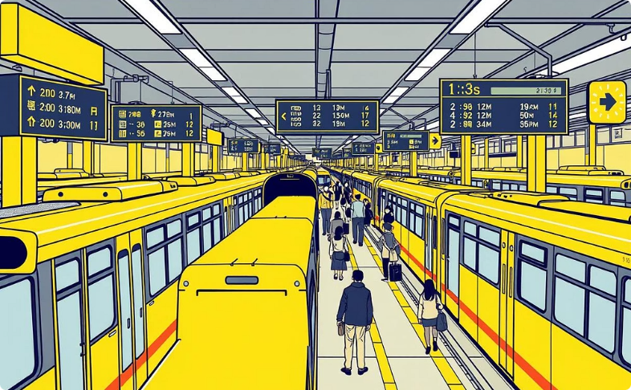
Real-World Applications & Benefits
Universities
Healthcare
Transportation
Optimize course scheduling, minimize student conflicts, improve facility utilization, reduce scheduling time from weeks to hours
Coordinate staff shifts while respecting labor laws, ensuring optimal coverage and reducing scheduling errors that impact patient care
Create efficient transit schedules that minimize passenger wait times and optimize resource allocation across networks

Slide 9
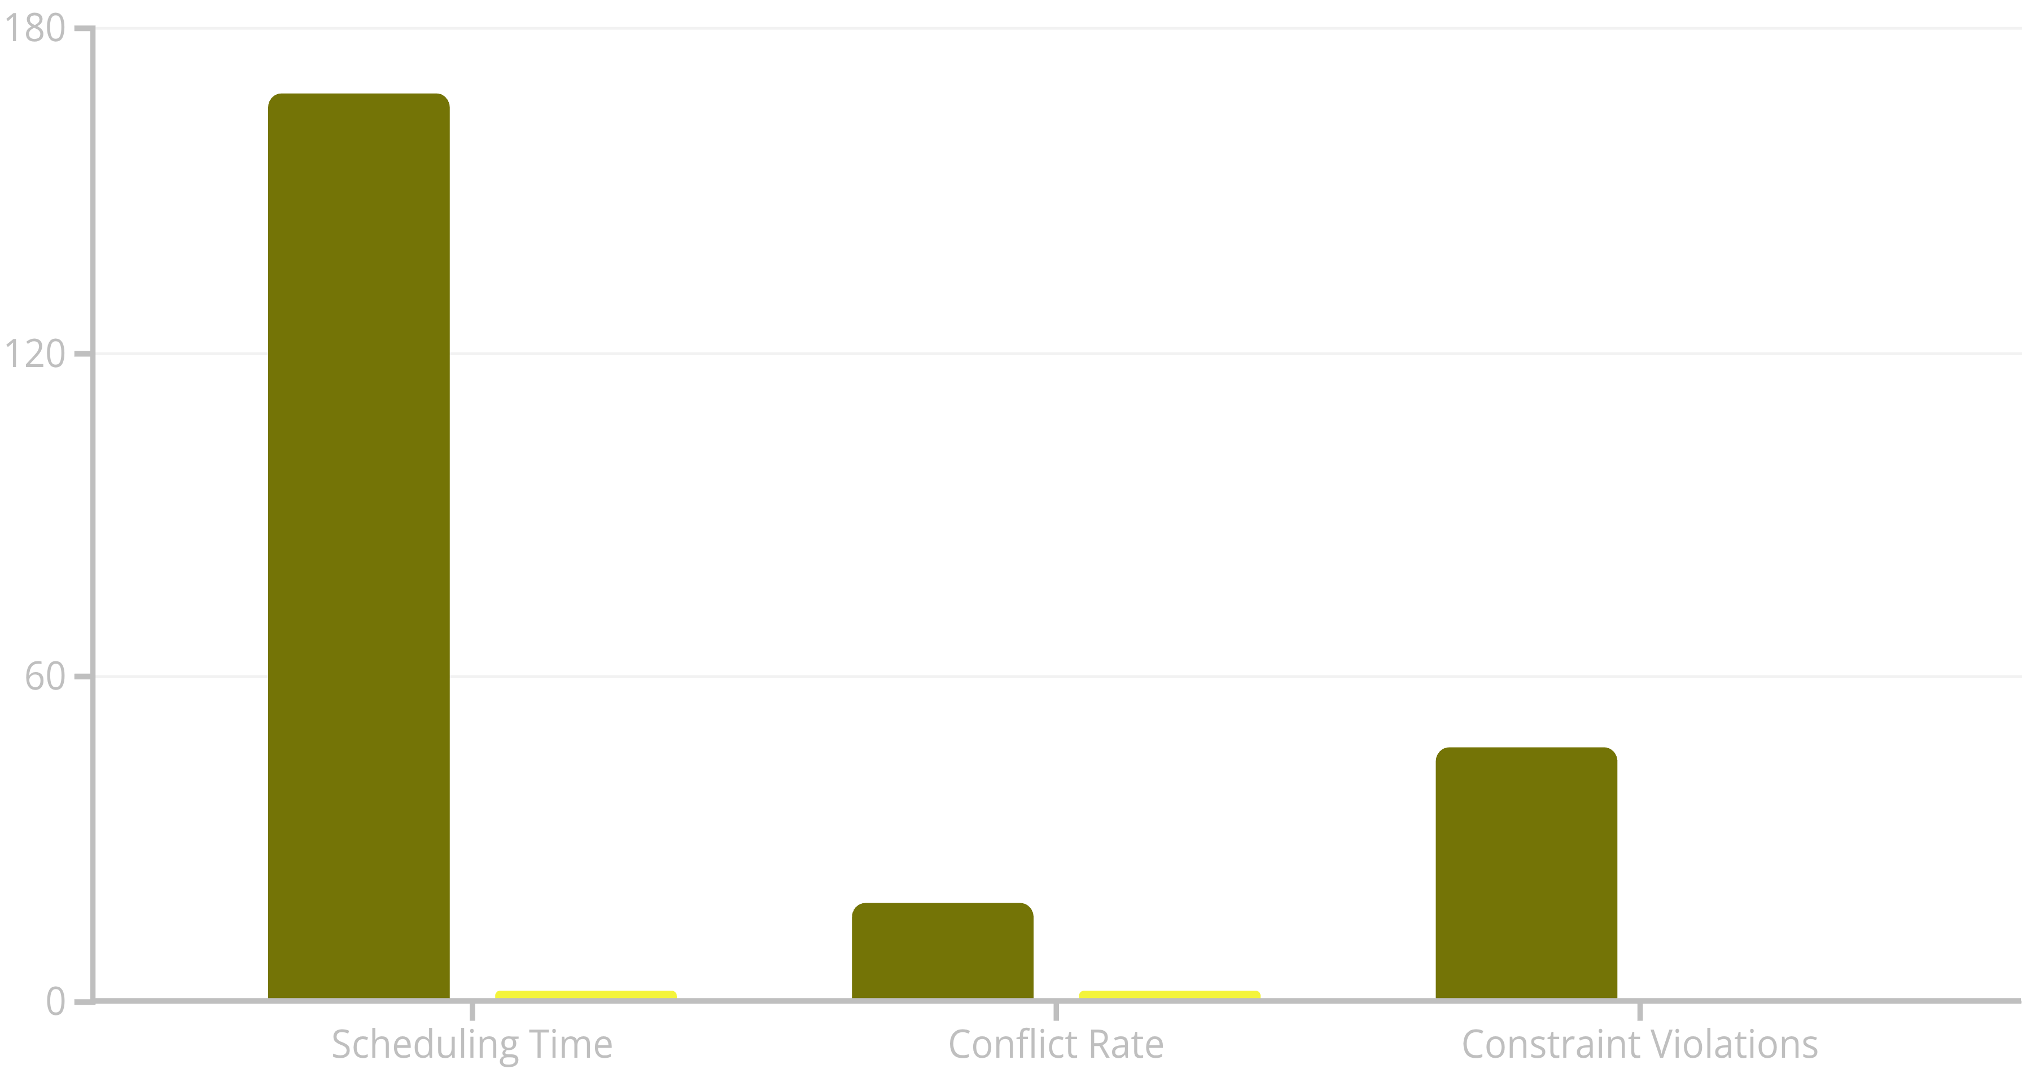
Case Study: University Timetable Optimization
Challenge: A mid-size university struggled scheduling 1,200 courses across 45 rooms with 350 instructors. Manual methods produced 15-20% conflicts.
Traditional
AI-Powered
Results: 98% conflict reduction, scheduling time decreased from 168 hours to 2 hours, and 100% hard constraint satisfaction achieved within first generation.

Slide 10



Q&A and Future Directions
1
Machine Learning Integration
Predictive models learn historical scheduling preferences and automatically adjust constraints for improved personalization
2
Real-Time Adaptation
AI systems dynamically reschedule when conflicts arise, enabling responsive management of sudden changes
3
Broader Adoption
Expanding beyond universities to hospitals, logistics, and industries facing complex scheduling challenges

